Slide 1
ESL Reading and Writing
Level 3
Intensive English Program

Slide 2
From Paragraph to Essay
If you can write a good paragraph, you will no doubt write a good essay!
Essay
Paragraph

Slide 3
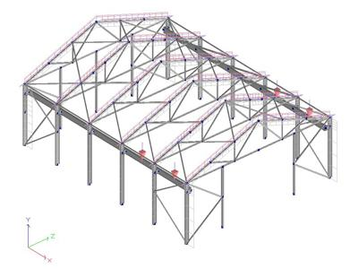
Elements of a good paragraph:
# 1: Structure

Slide 4
Linear as opposed to Circular
on the topic

Slide 5
Staying on Topic...
Click here

Slide 6
# 2: Topic Sentence
Topic Sentence
Main Idea + Controlling idea
my favorite season
Winter
dangerous driving
your idea?

Slide 7
Remember!
Your Topic Sentence tells the reader what your paragraph is about!

Slide 8
#3: Support your Topic Sentence!
Once you inform the reader about your
Topic Sentence, provide him/her with examples:
TOPIC SENTENCE
Supporting detail 1
Supporting detail 2
Supporting detail 3

Slide 9
# 4: Make a Conclusion
Your Topic Sentence & Supporting details
CONCLUSION: Summarize or restate your main points,
make a prediction,
or offer a solution.

Slide 10
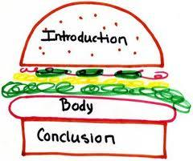
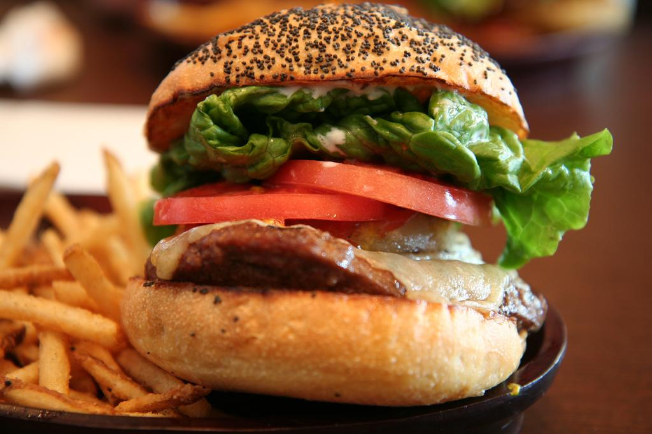
Visualize Your Paragraph
Introduction
Body
Conclusion

Slide 11
Your turn to practice...
Write your own paragraph. Be sure to include:
Topic sentence & Controlling idea
Supporting details
Concluding sentences
(1 paragraph - 1 topic)

Slide 12
Activity: Brainstorm
support
support
TOPIC
support
support
support
support

Slide 13
Writing Activity - 30 min

Slide 14
Peer- Review Activity
Read your classmate's paragraph and:
1. Underline the topic sentence
2. Circle the controlling idea
3. Number the supporting sentences
4. Highlight the concluding sentence

Slide 15
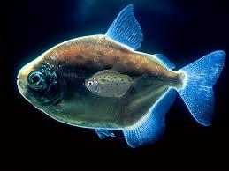
Have you heard about FISH??

Slide 16
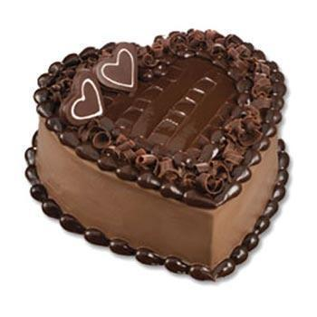
What do a good paragraph and a
delicious cake have in common?
Winter
Winter is my favorite season because I like the clothes, the food and the activities. In the winter, I can wear a big coat and my favorite sweater. When it's cold, I can eat hot foods and soup. I can drink hot chocolate too. Best of all, in the winter I can do a lot of activities. I can play in the snow and make a snowman. I can go skiing, ice skating, or stay at home by the fireplace. That's why winter is my favorite season.
Notes:
*

Slide 17
They are both enjoyable to read/eat!
All of the supporting ideas/ingredients
belong together!
Winter
Winter is my favorite season because I like the clothes, the food and the activities. In the winter, I can wear a big coat and my favorite sweater. When it's cold, I can eat hot foods and soup. I can drink hot chocolate too. Best of all, in the winter I can do a lot of activities. I can play in the snow and make a snowman. I can go skiing, ice skating, or stay at home by the fireplace. That's why winter is my favorite season.
Notes:
*

Slide 18
Which ingredients DO NOT belong in a cake?
sugar
eggs
flour
fish
milk
Notes:
*

Slide 19
Which ingredients DO NOT belong in a cake?
sugar
eggs
flour
fish
milk
X
Notes:
*

Slide 20
Which sentences do not belong in a paragraph about “why winter is my favorite season?”
In the winter, I can wear a big coat and my favorite sweater.
Summer can be a lot of fun too.
I can go skiing, ice skating, or stay at home by the
fireplace.
Driving can be very dangerous in the winter.
When it's cold, I can eat hot foods and soup.
Notes:
*

Slide 21
Which sentences do not belong in a paragraph about “why winter is my favorite season?”
In the winter, I can wear a big coat and my favorite sweater.
Summer can be a lot of fun too.
I can go skiing, ice skating, or stay at home by the fireplace.
Driving can be very dangerous in the winter.
When it's cold, I can eat hot foods and soup.
_____________
_____________
Notes:
*

Slide 22
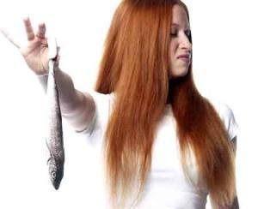
Keep those fish
OUT of your paragraphs!
Notes:
*

Slide 23
From Paragraph to Essay
INTRO
Support 1
Topic Sentence
Support 1
Support 2
Support 3
Conclusion
Support 2
BODY
Support 3
Conclusion

Slide 24
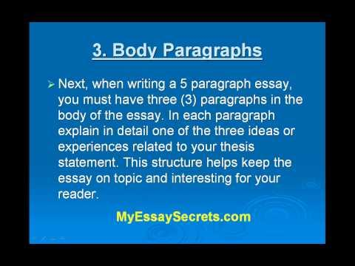
How To Write an Essay

Slide 25
Let's Take a Quiz!

Slide 26
Or.....play a game!
GAME

Slide 27
Finally...
Be prepared to write
your OWN essay!

Slide 28
References:
http://education.wichita.edu/caduceus/examples/essay_student/index.htm
google images
"Fish" part: courtesy by Tracy Day

